Slide 1
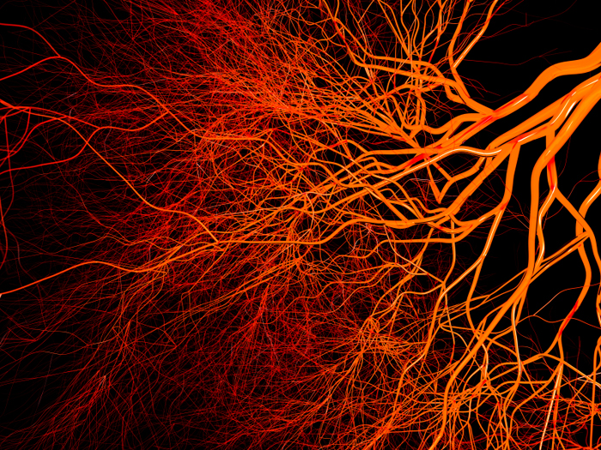

Vascular Endothelial Growth Factor (VEGF)
Professor:
Dr. T.minaii
Presenters:
Sina Abedini – Mahroo Hajimehdi

Slide 2

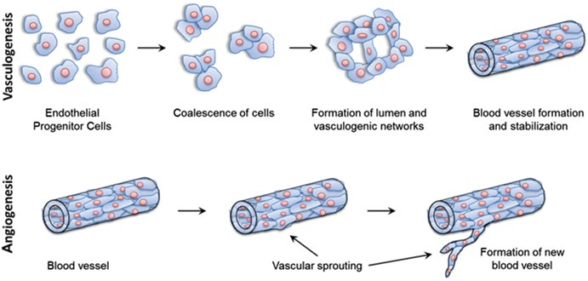
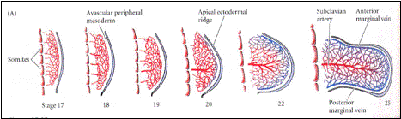
Introduction
Vascular endothelial growth factor (VEGF) vascular permeability factor (VPF)
member of the PDGF/VEGF growth factor family.
factor induces proliferation and migration of vascular endothelial cells
is essential for both physiological and pathological angiogenesis.
The activities of VEGF are not limited to the vascular system; VEGF plays a role in normal physiological functions such as:
bone formation
hematopoiesis
wound healing
development.

Slide 3
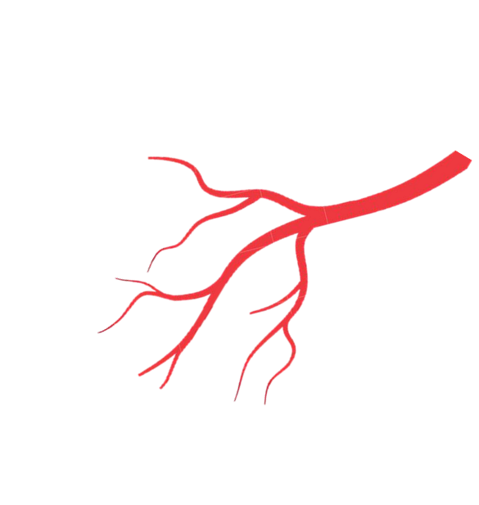
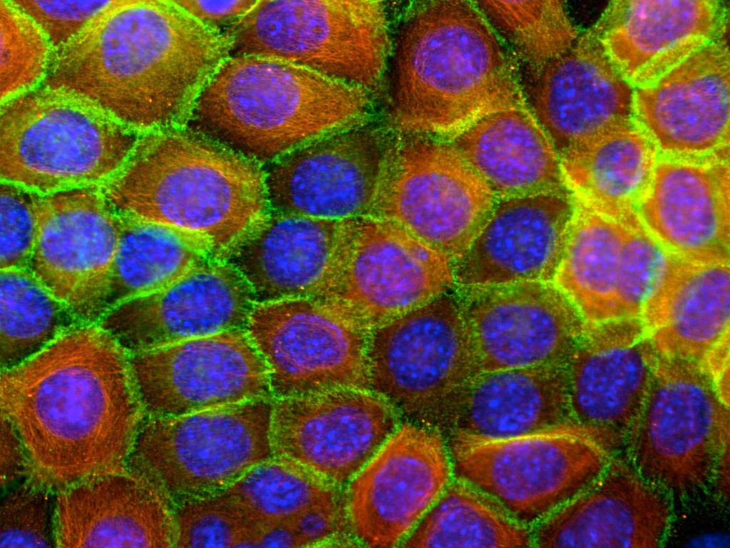
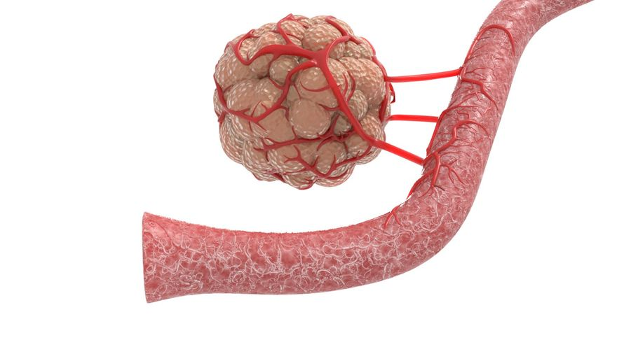
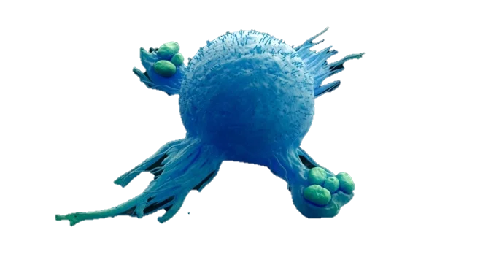
VEGF is produced by many cell types including:
tumor cells,
macrophages,
platelets,
keratinocytes

Slide 4
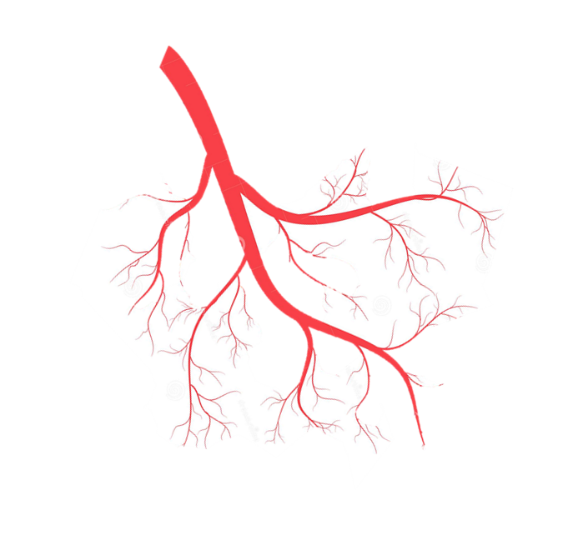
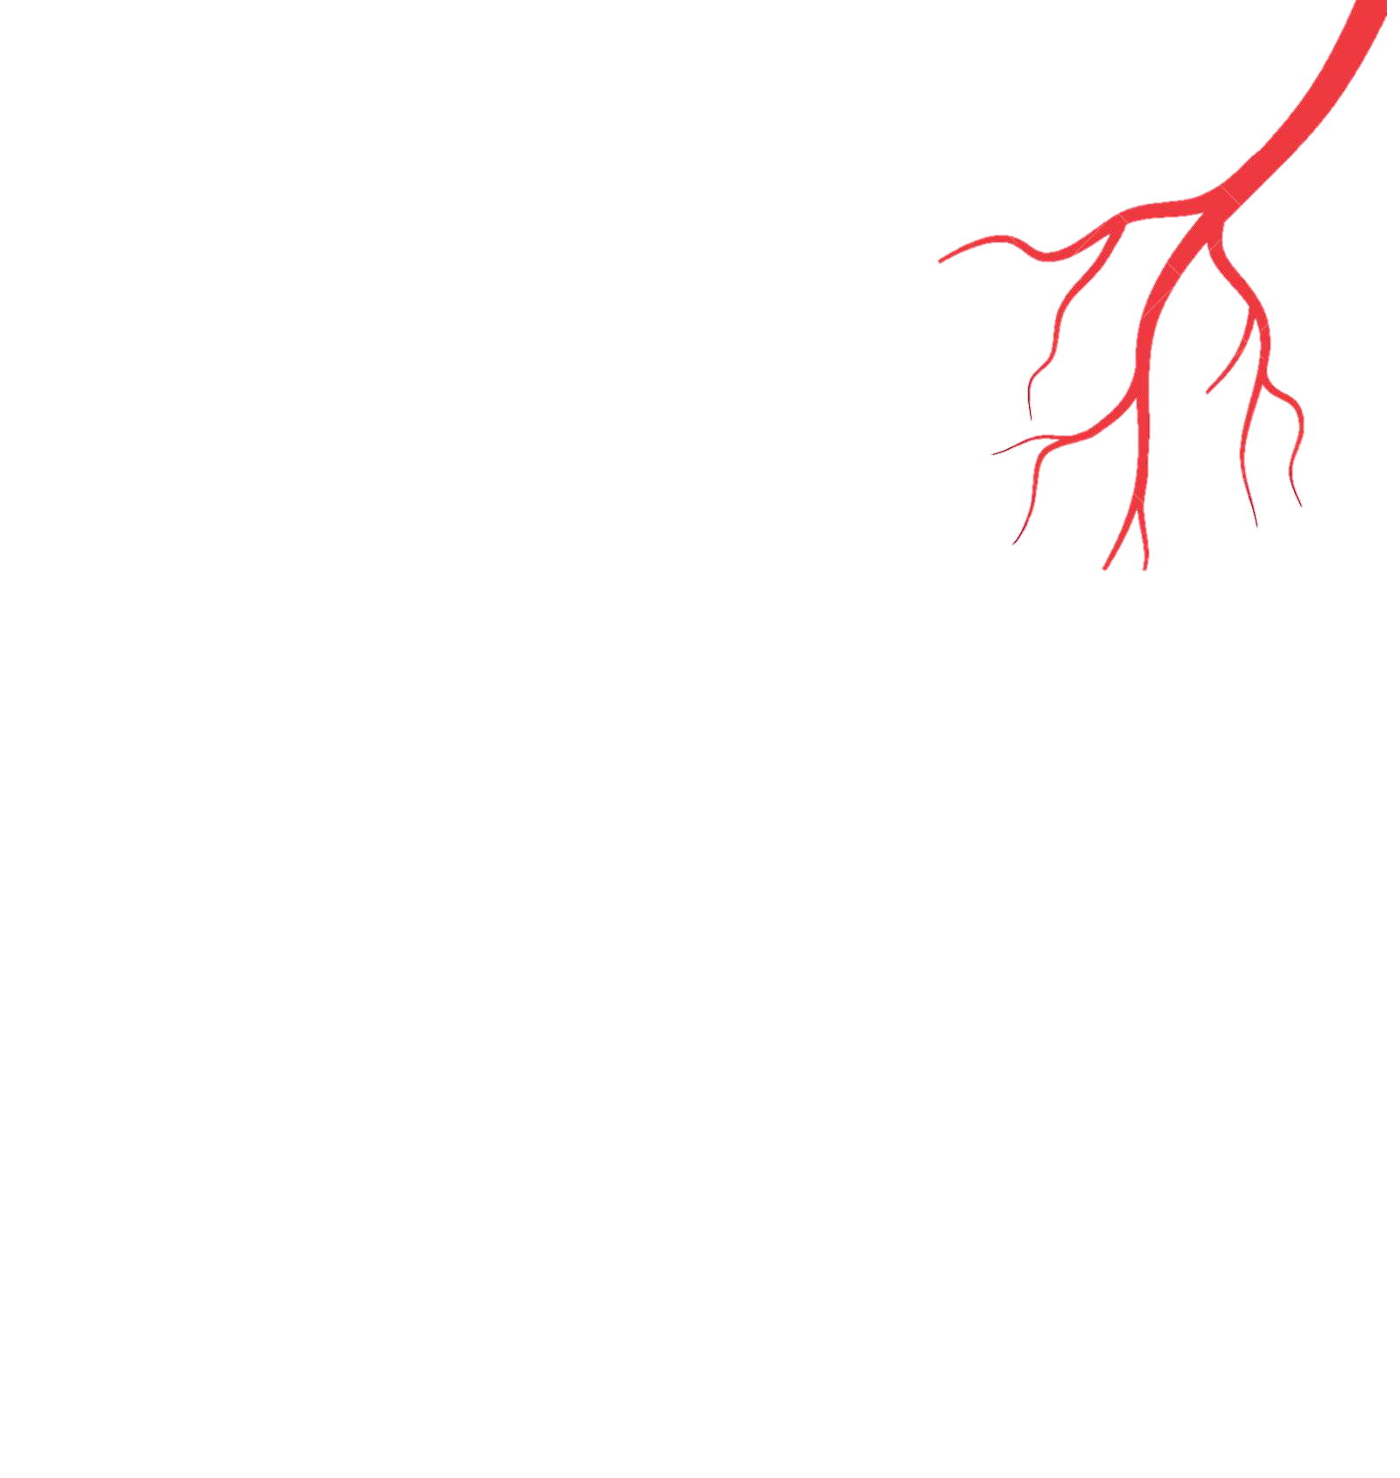

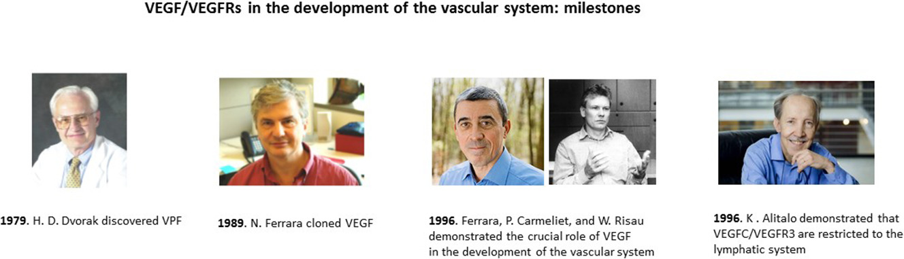
History
In 1979, Harold D. Dvorak found that supernatants from cell-free supernatants of tumors generated an intense blue spot Dvorak called this tumor supernatant permeabilizing activity vascular permeability factor (VPF),
In 1983 Senger et al. identified a vascular permeability factor secreted by tumors in guinea pigs and hamsters
In 1989 Ferrara and Henzel described an identical factor in bovine pituitary follicular cells which they purified, cloned and named VEGF
Between 1996 and 1997, Christinger and De Vos obtained the crystal structure of VEGF, first at 2.5 Å resolution and later at 1.9 Å

Slide 5

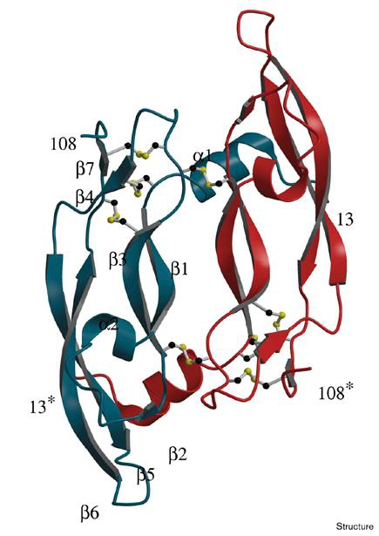
Protein structure
Homodimeric member of the cystine knot family of growth factors
antiparallel homodimer covalently linked by two disulfide bridges between Cys-51 and Cys-60.
cystine knot motif is found in other growth factors:
eight-residue ring formed by the disulfide bridges Cys-57–Cys-102 and Cys-61–Cys-104,
with a third disulfide bond (Cys-26–Cys-68) passing through it.
From this motif extends a central four-stranded β-sheet
In the VEGF dimer, the 2-fold axis is perpendicular to the sheet, resulting in an antiparallel orientation of the monomers with the two four-stranded sheets side by side

Slide 6
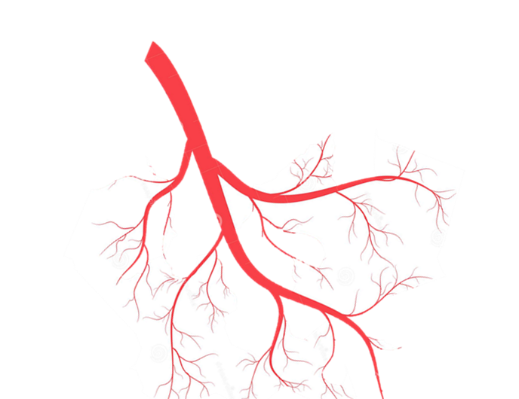
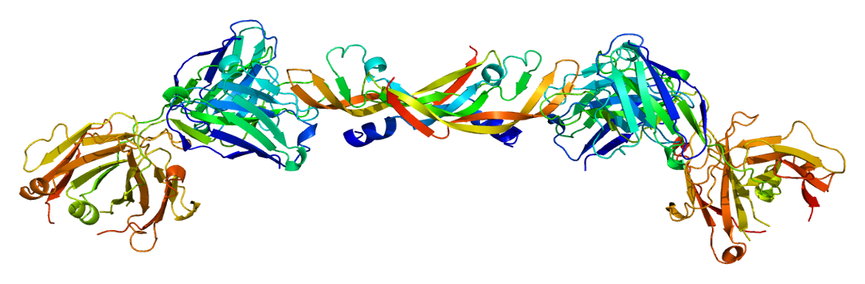
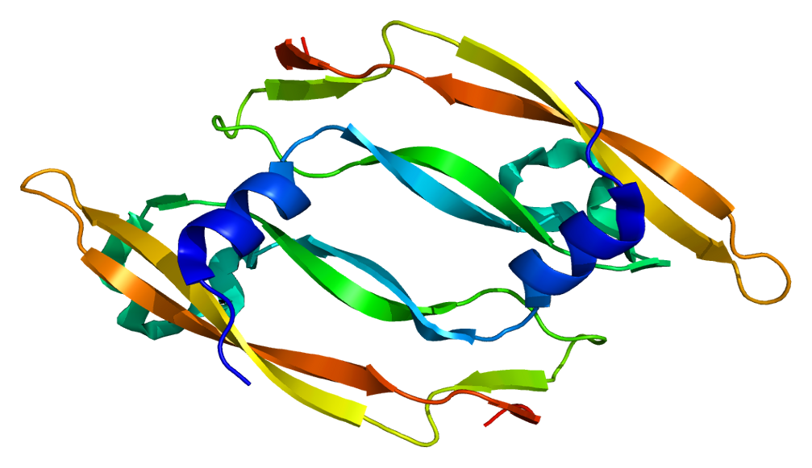
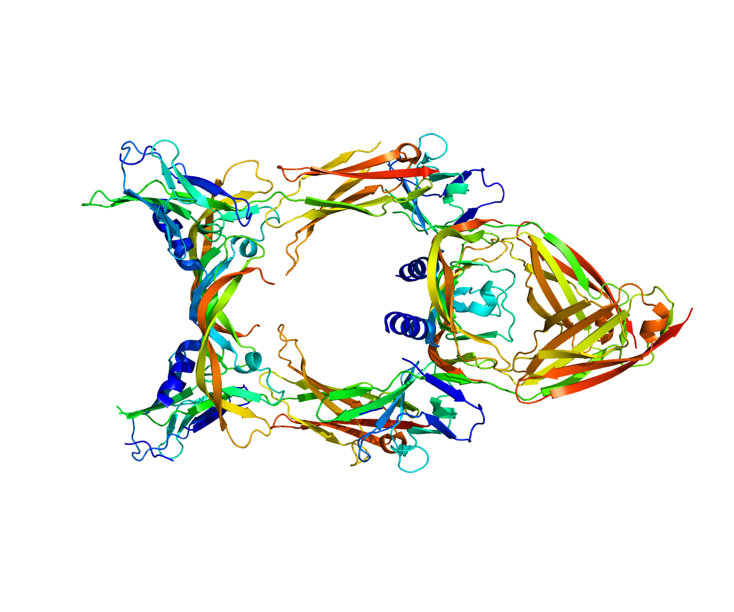
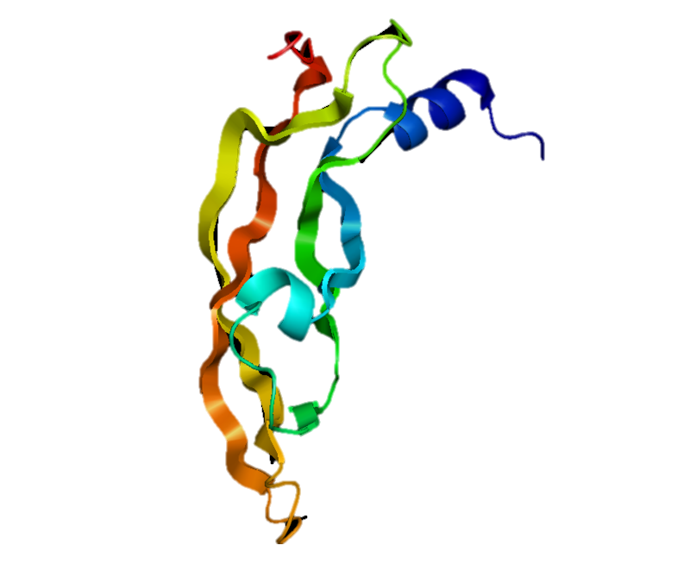
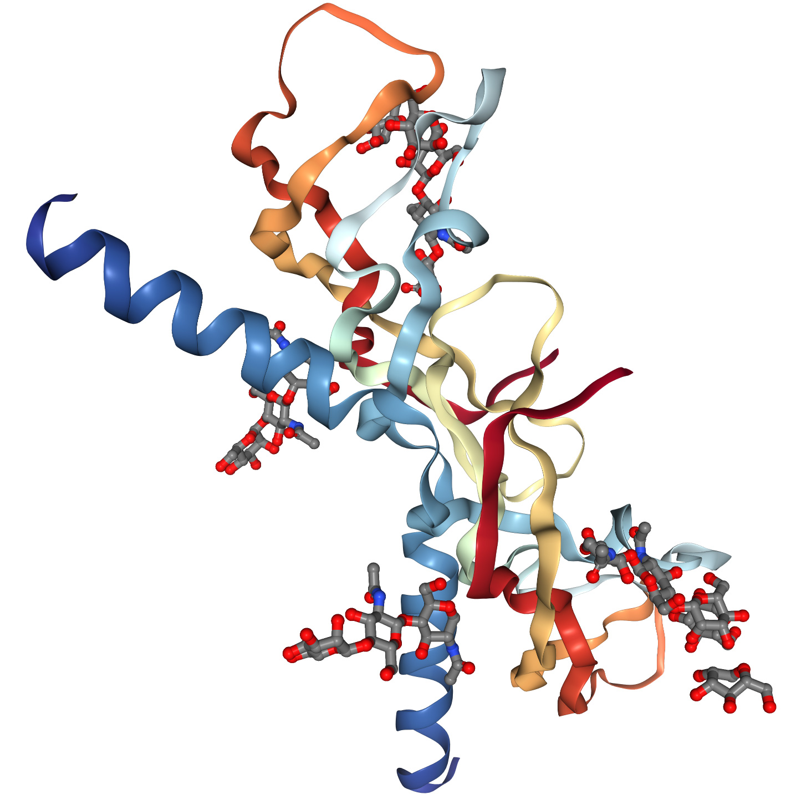
Classification
VEGF-A
In mammals, the VEGF family comprises five members:
VEGF-A
placenta growth factor (PGF),
VEGF-B
VEGF-C
VEGF-D
A number of VEGF-related proteins encoded by viruses (VEGF-E) and in the venom of some snakes (VEGF-F) have also been discovered.
VEGF-B
VEGF-D
VEGF-C
VEGF-F

Slide 7
Type
Function
Angiogenesis
↑ Migration of endothelial cells
↑ mitosis of endothelial cells
↑ αvβ3 activity
↑ Matrix metalloproteinase activity
creation of blood vessel lumen
creates fenestrations
Chemotactic for macrophages and granulocytes
Vasodilation (indirectly by NO release)
Lymphangiogenesis
VEGF-A
VEGF-B
Embryonic angiogenesis (myocardial tissue, to be specific)
VEGF-C
Lymphangiogenesis
VEGF-D
Needed for the development of lymphatic vasculature surrounding lung bronchioles

Slide 8

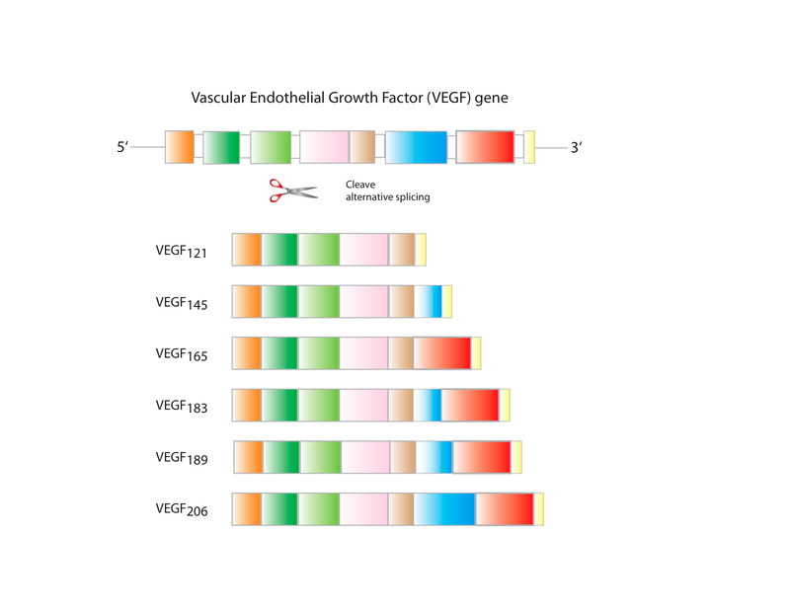
Isoforms
There are multiple isoforms of VEGF-A that result from alternative splicing of mRNA from a single, 8-exon VEGFA gene.
These are classified into two groups which are referred to according to their terminal exon (exon 8) splice site:
the proximal splice site (denoted VEGF_{xxx})
distal splice site (VEGF_{xxx}b).
In addition, alternate splicing of exon 6 and 7 alters their heparin-binding affinity and amino acid number (in humans: VEGF121, VEGF121b, VEGF145, VEGF165, VEGF165b, VEGF189, VEGF206; the rodent orthologs of these proteins contain one fewer amino acids).
These domains have important functional consequences for the VEGF splice variants:
terminal (exon 8) splice site determines whether the proteins are pro-angiogenic (proximal splice site, expressed during angiogenesis) or anti-angiogenic (distal splice site, expressed in normal tissues).

Slide 9
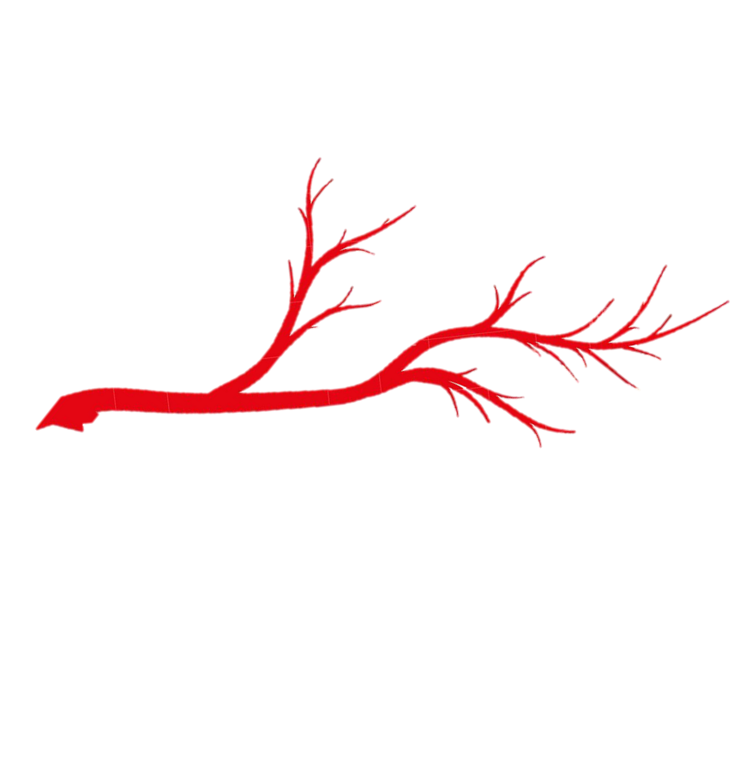
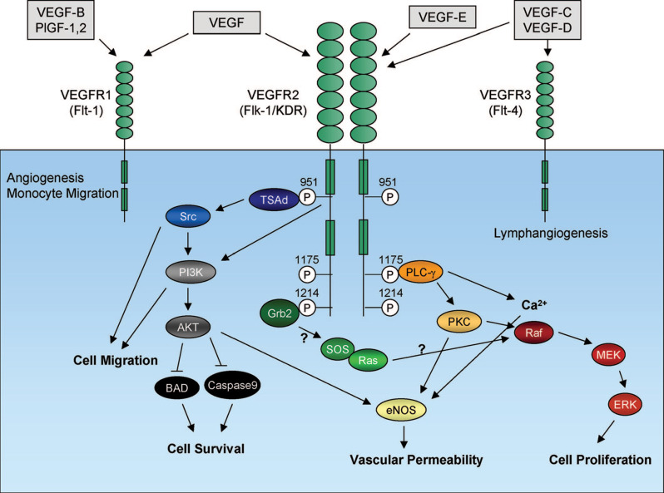
Function and Mechanism
VEGF signaling protein
VEGF receptor
Stimulation of vasculogenesis and Angiogenesis
All members of the VEGF family stimulate cellular responses by binding to tyrosine kinase receptors (the VEGFRs) on the cell surface, causing them to dimerize and become activated through transphosphorylation, although to different sites, times, and extents.

Slide 10

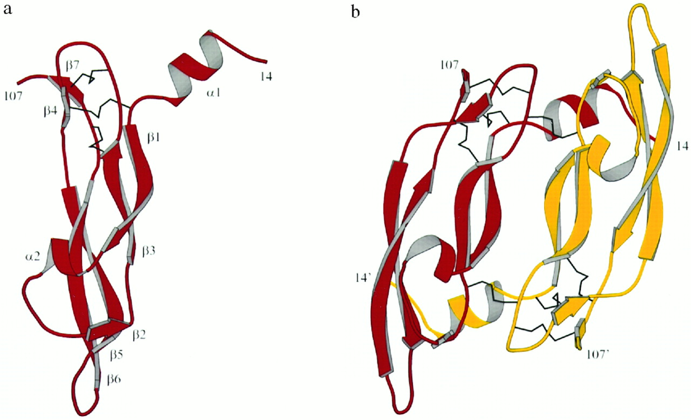
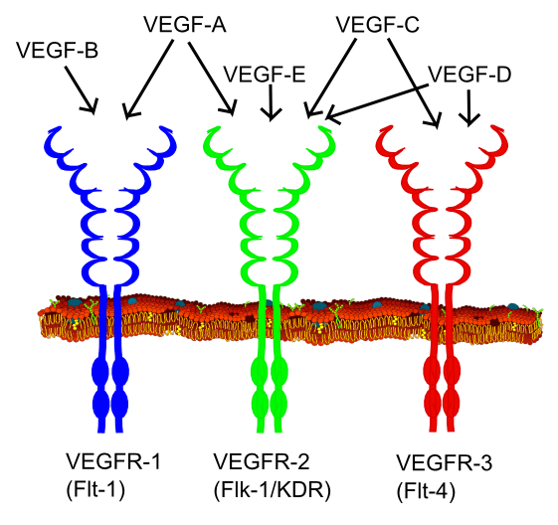
Receptor
There are three main subtypes of VEGFR, numbered 1, 2 and 3. Also, they may be membrane-bound (mbVEGFR) or soluble (sVEGFR), depending on alternative splicing.
The VEGF receptors have an extracellular portion consisting of 7 immunoglobulin-like domains, a single transmembrane spanning region, and an intracellular portion containing a split tyrosine-kinase domain
VEGF-A binds to VEGFR-1 (Flt-1) and VEGFR-2 (KDR/Flk-1).
VEGFR-2 appears to mediate almost all of the known cellular responses to VEGF.
VEGF-C and VEGF-D, but not VEGF-A, are ligands for a third receptor (VEGFR-3/Flt4), which mediates lymphangiogenesis.

Slide 11
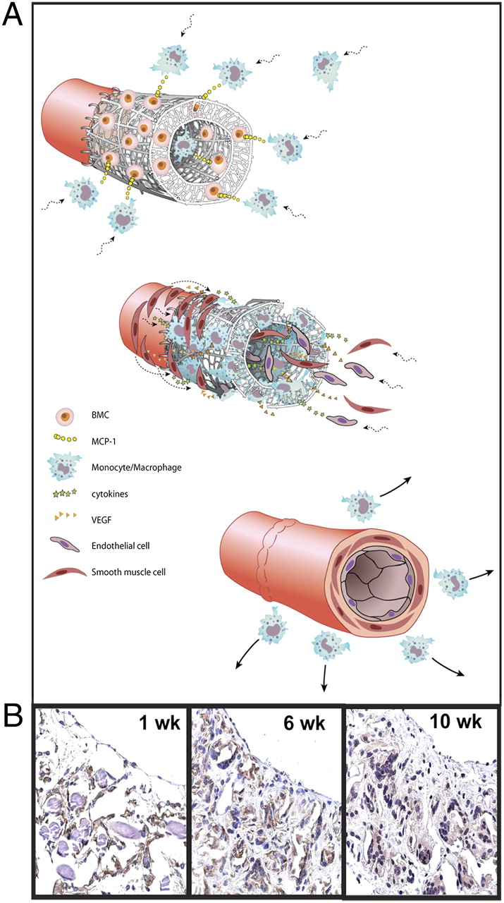
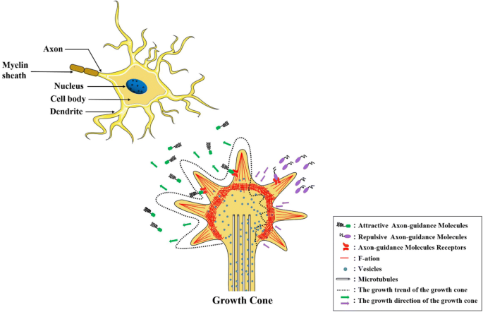
Roles of VEGF
VEGF in the Cardiovascular System
Myofibroblasts play a major role in the growth, development and repair of normal tissue and are found at the site of infarction
VEGF contributes to tissue remodelling at the site of infarction in an autocrine manner
VEGF and the Central Nervous System (CNS)
In the central nervous system (CNS) both positive (pro-migratory) and negative (anti-migratory) regulatory factors are essential for axonal guidance
Sema3A, a member of the semaphorin family, acts as an inhibitor of neuronal migration and induces neuronal cell death through the neuropilin-1 receptor (NP-1)
NP-1 also acts as an additional receptor for VEGF₁₆₅ isoform
VEGF₁₆₅ or anti-NP-1 antibody blocked the effect of Sema3A on undifferentiated
VEGF has a neurotrophic effect and enhances survival of Schwann cells
VEGF and Its Role in Bone
VEGF is produced by hypertrophic chondrocytes in the growth plate where it co-ordinates extracellular matrix (ECM) remodelling, angiogenesis, and bone formation.

Slide 12
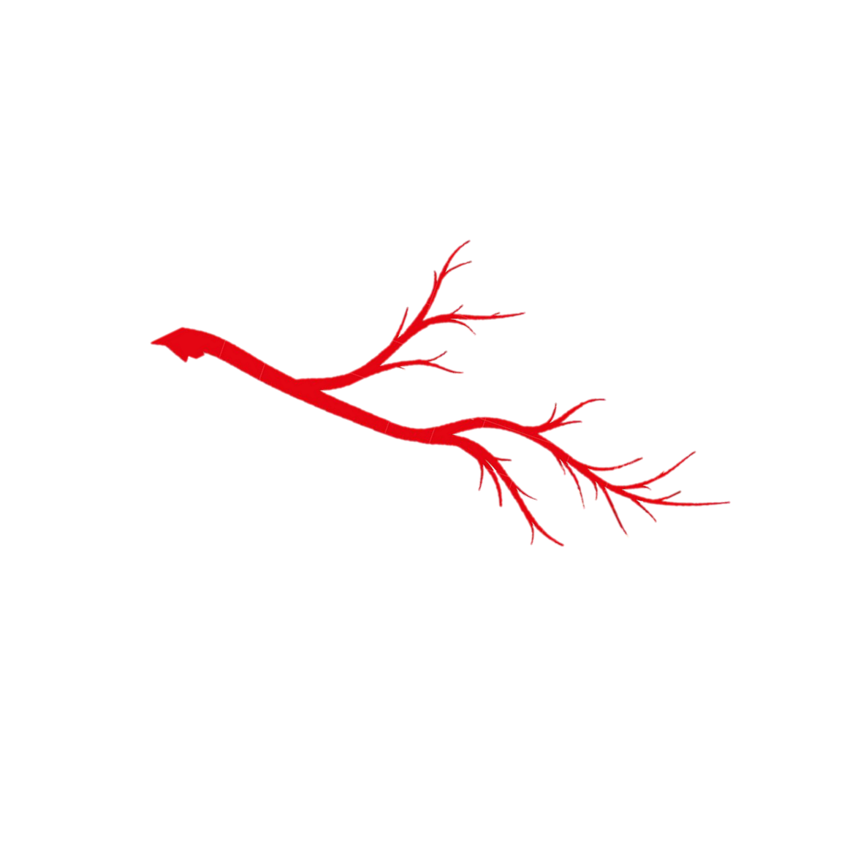
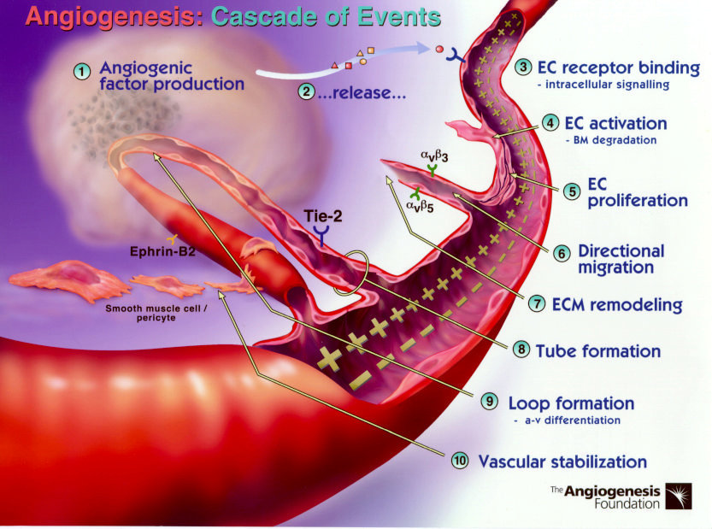
Oxygen sensing and expression of VEGF
VEGF-A production can be induced in a cell that is not receiving enough oxygen.
When a cell is deficient in oxygen, it produces HIF, hypoxia-inducible factor, a transcription factor.
HIF stimulates the release of VEGF-A, among other functions (including modulation of erythropoiesis).
Circulating VEGF-A then binds to VEGF receptors on endothelial cells, triggering a tyrosine kinase pathway leading to angiogenesis.
The expression of angiopoietin-2 in the absence of VEGF leads to endothelial cell death and vascular regression.

Slide 13

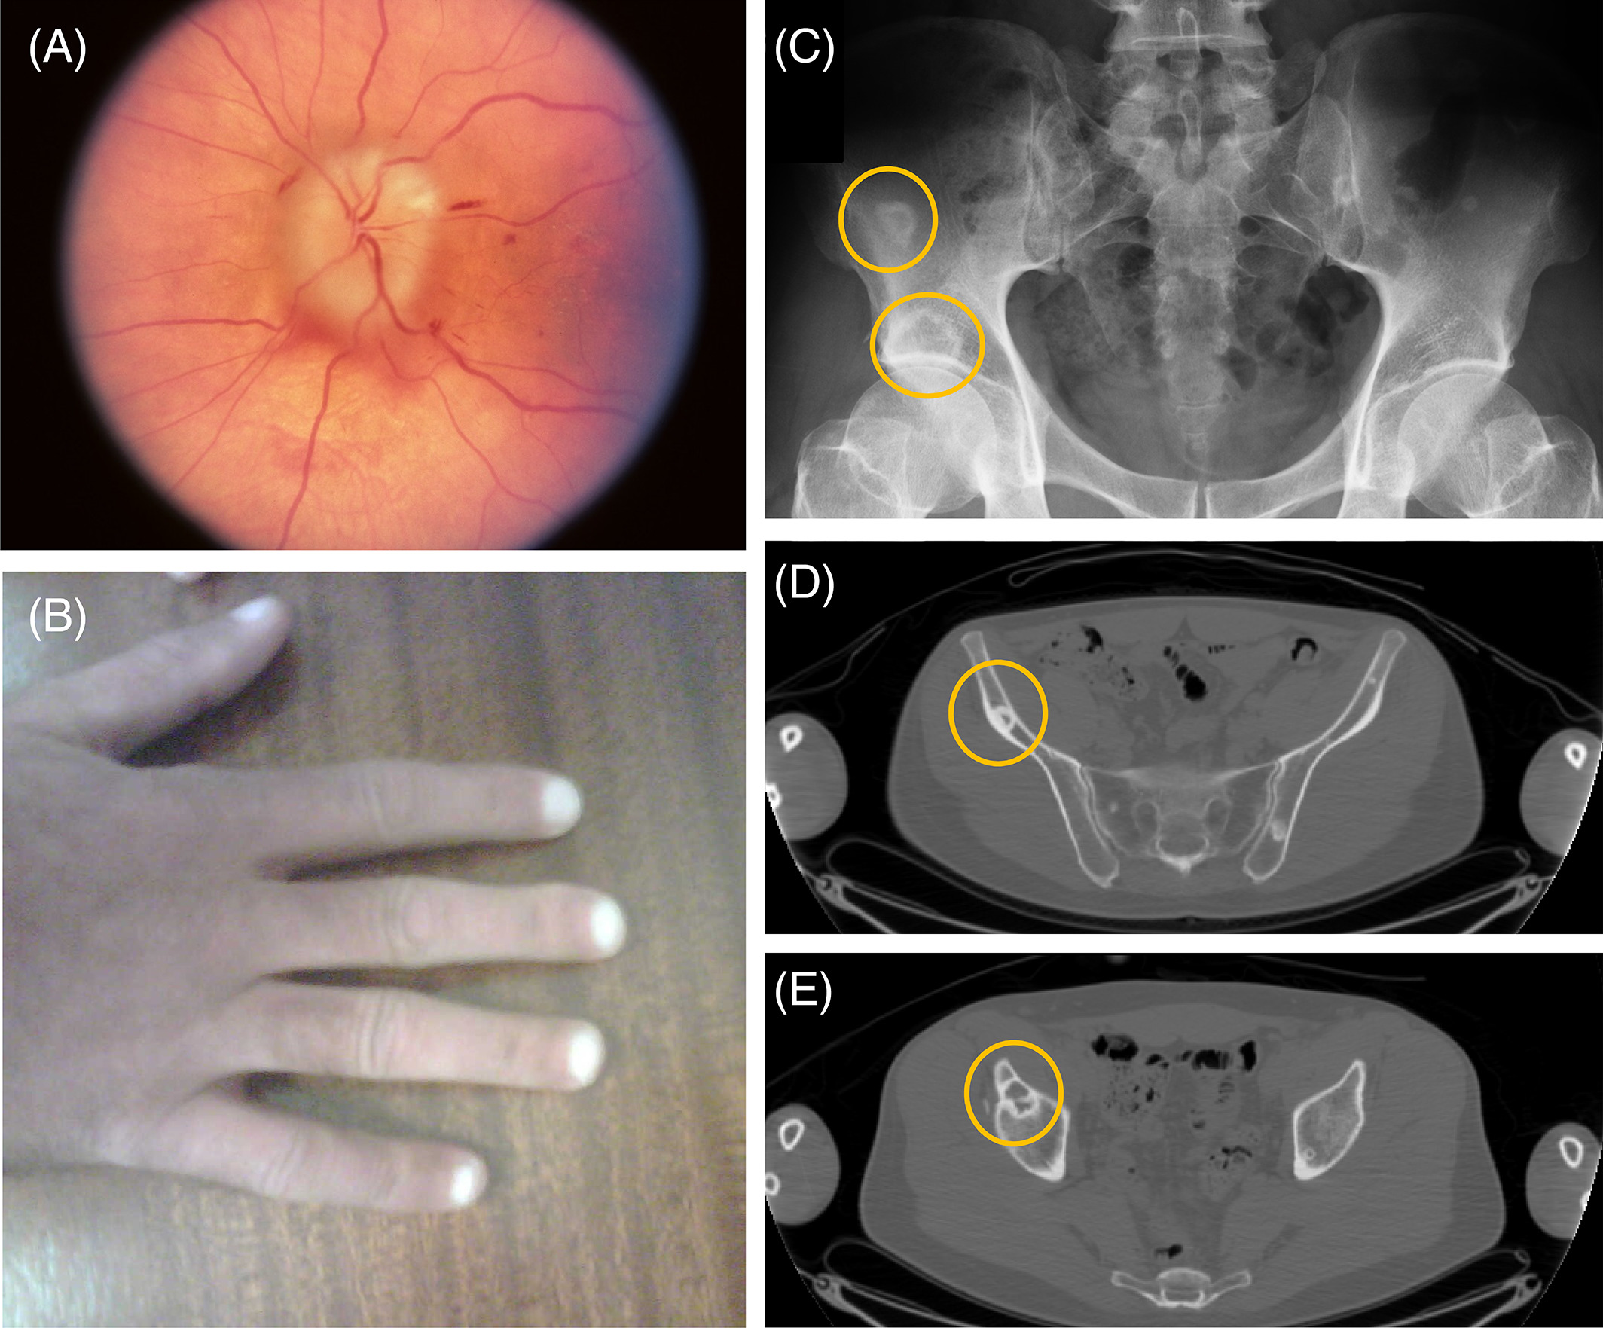
Role of VEGF in Disease
Cancer: Anti-VEGF strategies to treat cancers were designed to target the pro-angiogenic function of VEGF and thereby inhibit neovascularization.
POEMS syndrome:
Elevated levels of this protein are found in patients with POEMS syndrome, also known as Crow-Fukase syndrome.
Allelic variants of this gene have been associated with microvascular complications of diabetes 1 (MVCD1) and atherosclerosis
VEGF-A is also important in diabetic retinopathy (DR). The microcirculatory problems in the retina of people with diabetes can cause retinal ischaemia
CNS: VEGF-A and the corresponding receptors are rapidly up-regulated after traumatic injury of the central nervous system (CNS).
In the kidney, increased expression of VEGF-A in glomeruli directly causes the glomerular hypertrophy that is associated with proteinuria
VEGF-A is also released in rheumatoid arthritis in response to TNF-α, increasing endothelial permeability and swelling and also stimulating angiogenesis (formation of capillaries

Slide 14
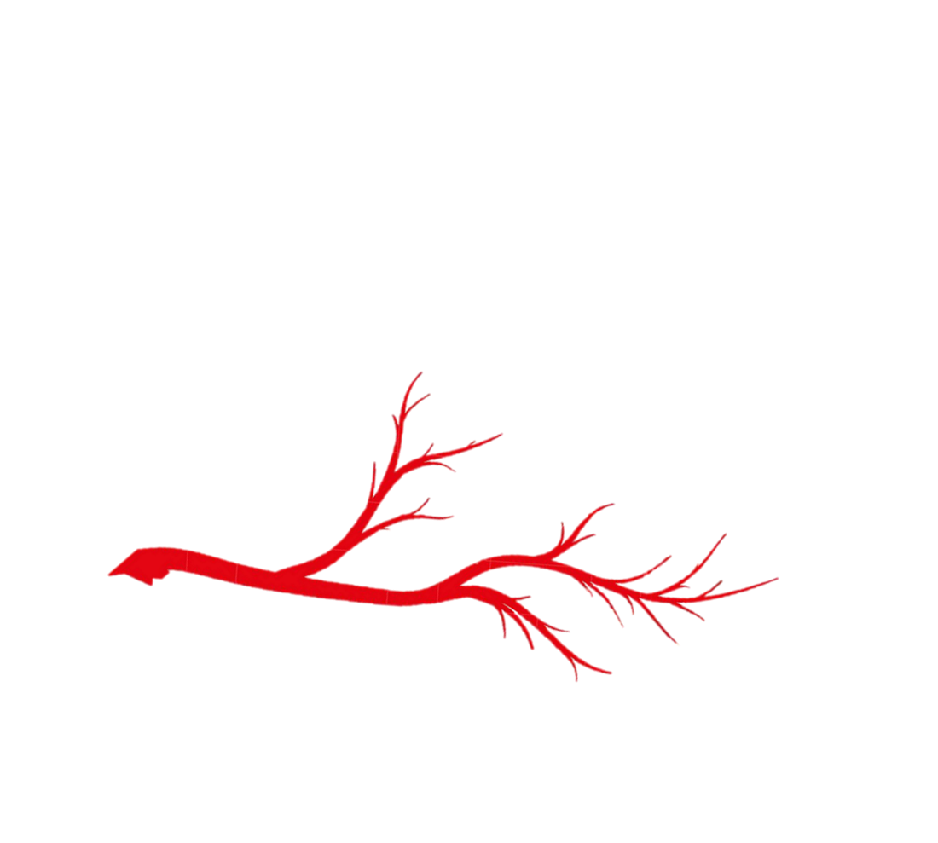
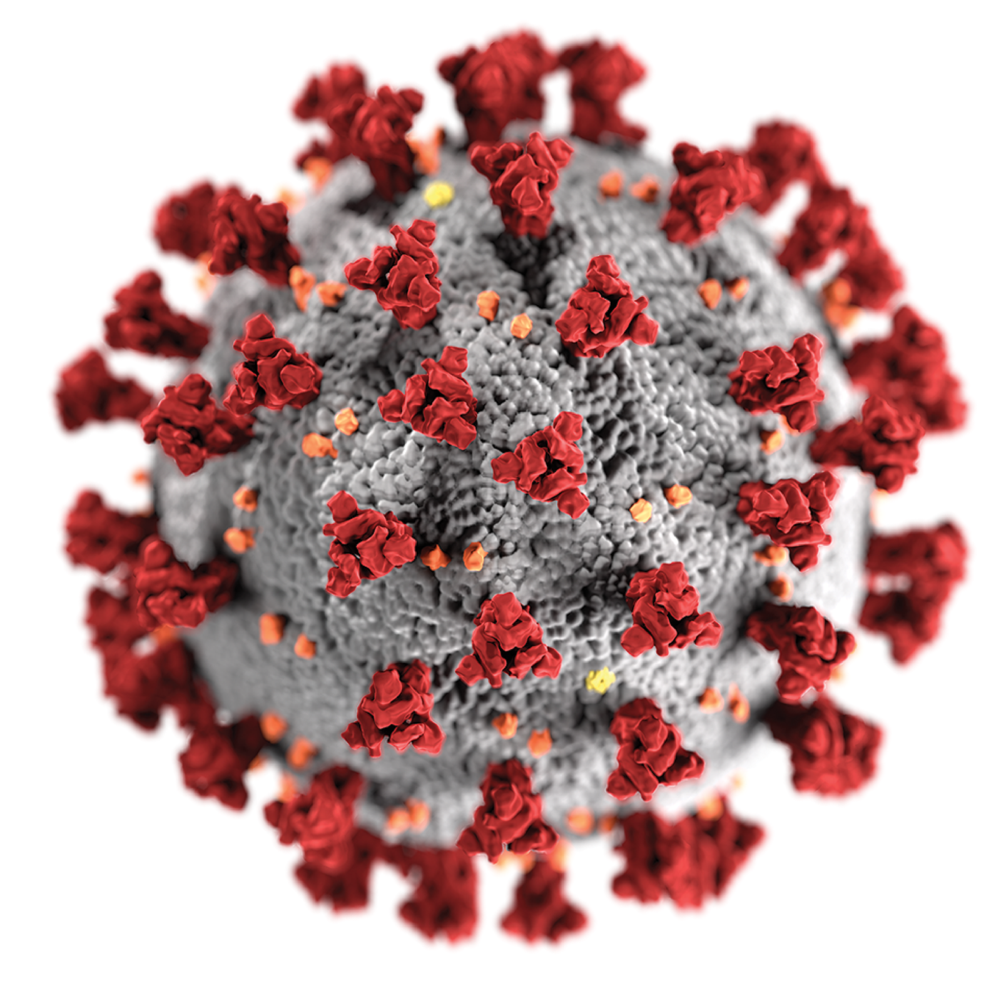

A special case of VEGF: Corona
The levels of VEGF are increased during infection with severe acute respiratory syndrome coronavirus 2 (SARS-CoV-2)
promoting inflammation by facilitating recruitment of inflammatory cells, and by increasing the level of angiopoietin II (Ang II), one of two products of the SARS-CoV-2 binding target, angiotensin-converting enzyme 2 (ACE2).
In turn, Ang II facilitates the elevation of VEGF, thus forming a vicious cycle in the release of inflammatory cytokines

Slide 15
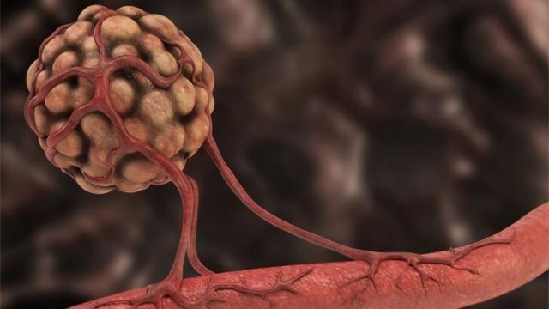
References:
Duffy AM, Bouchier-Hayes DJ, Harmey JH. Vascular Endothelial Growth Factor (VEGF) and Its Role in Non-Endothelial Cells: Autocrine Signalling by VEGF.
Muller YA, Li B, Christinger HW, Wells JA, Cunningham BC, de Vos AM. Vascular endothelial growth factor: crystal structure and functional mapping of the kinase domain receptor binding site.
Vascular endothelial growth factor From Wikipedia, the free encyclopedia
VEGFA vascular endothelial growth factor A [ Homo sapiens (human) https://www.ncbi.nlm.nih.gov/gene/7422

